Slide 1
Polynomials
Lesson 8-1
Adding and subtracting

Slide 2
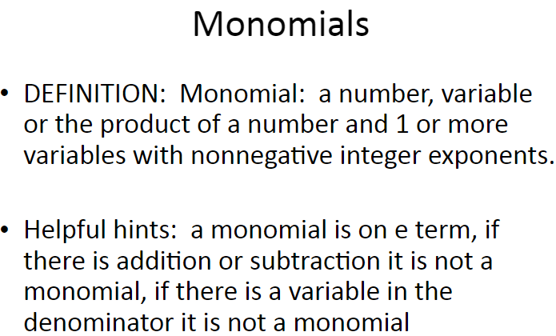
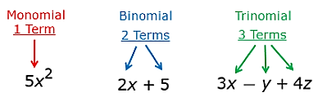
A polynomial is a monomial or a sum of monomials.
A binomial is the sum of two monomials, and a trinomial Is the sum of three monomials.
Polynomials with more than three terms have no special name.
Polynomials

Slide 3
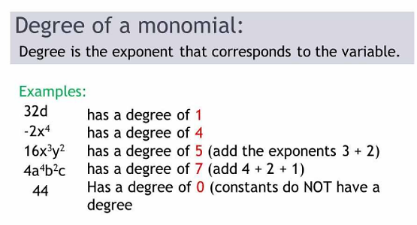
Degree
The degree of a monomial is the sum of the exponents of all its variables.
The degree of the polynomial is the same as the degree of the monomial term with the highest degree.
.

Slide 4
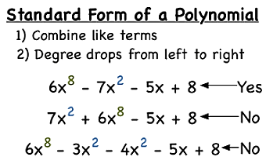
standard form of a polynomial
The terms of a polynomial are usually arranged so that the terms are in order from greatest degree to least degree. This is called the standard form of a polynomial

Slide 5
Multiplying binomials
3 Methods
Distributive Method (a.k.a h Horizontal Method)
Punnet Square Method (a.k.a Box Method)
FOIL Method

Slide 6
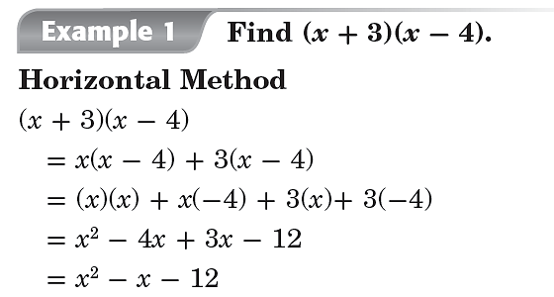
Distributive mETHOD
a.k.a Horizontal Method

Slide 7
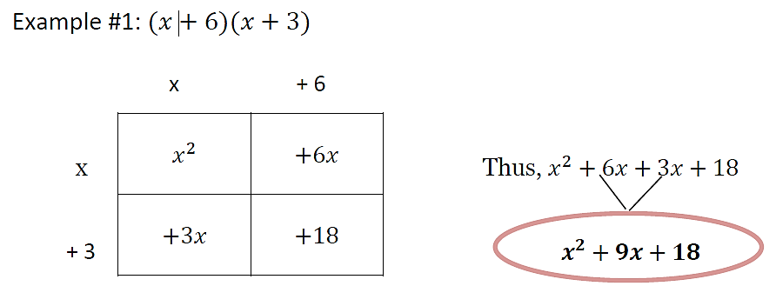
Punnet SQuare
a.k.a Box Method

Slide 8
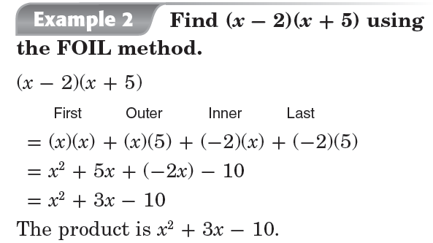
FOIL Method

